Slide 1
LOGISTICS MANAGEMENT SYSTEM
Project presentation
TEAM MEMBERS:
PAVAN GANDHI (202118008)
DHVANI GOLANI (202118020)
PRANAY KOTHARI (202118010)
DEVARSH ANTANI (202112044)

Slide 2
Project description
Logistics management includes multiple processes that ensure seamless movement of goods, freight, parcels, raw materials, finished inventory and packages from its point of origin to end-customers.
Logistics is key to utilizing, planning, implementing and controlling the flow and storage of goods and services to meet customer requirements.
Efficient logistics management provides clear visibility of transportation activities involved in ensuring smooth supply chain operations.

Slide 3
Project scope
The logistics management system is used to meet customer demands through planning, control, and implementation of the effective movement and storage of related information, goods, and services from origin to destination.
Logistic management system software provides many features like Client list management, Processing orders, Fleet management, Transaction records.
This logistics management system project can track the transportation duration of goods.

Slide 4
ER Diagram
New folder\Logistic_management_system (1).png

Slide 5
Schema diagram
New folder\32_Relational_Schema.png

Slide 6
Functional dependency and normalisation forms
New folder\Final\32_Functional_Dependencies.docx

Slide 7
DDL script
New folder\Final\ddl_script.pdf

Slide 8
Insert statements
INSERT INTO department VALUES (1,'Management','Managing department’);
INSERT INTO Employee VALUES(1,'Pavan','Male',8764543562,'2015-08-03','Senior Manager',69000,1);
INSERT INTO Client VALUES('24ABCDE1234F1Z5','Dhvani',9932376544,'dhvani123@gmail.com','Vadodara','Gujarat','India',1);
INSERT INTO Orders VALUES(2021010001,'Car Transportation','07AAAAA0000A0Z0',4);
INSERT INTO Transactions VALUES(1,'successful','upi',40000.12,'2021-01-21','02:03:04',2021010001);
INSERT INTO Receiver VALUES('27CDFGH2356K8L9','Paul',9976543211,'paul23@gmail.com','Bombay','Maharastra','India',1);
INSERT INTO Transportation VALUES(1,'Bombay','2021-01-26','04:03:04','Vadodara','2021-02-15','03:30:21',2021010001,1,'24SAFWF7632M7S0');

Slide 9
Insert statement [Cont.]
INSERT INTO Transporter VALUES(1,'Chartered Logistics Ltd','Road');
INSERT INTO RoadTransport VALUES(8863,'TATA ACE',0.85,'2014-07-21',2);
INSERT INTO WaterTransport VALUES(2314563,'2006-04-30','Algoma Mariner',29,20,6);
INSERT INTO AirTransport VALUES(2491,'2010-07-23','BOEING B737-400F',20,8);
INSERT INTO Driver VALUES(101,'John','1989-06-13',9842844489,6783);
INSERT INTO Captain VALUES(201,'Robert','1978-03-22',9923498799,2314563);
INSERT INTO Pilot VALUES(301,'Jack','1986-03-22',9873212577,2491);

Slide 10
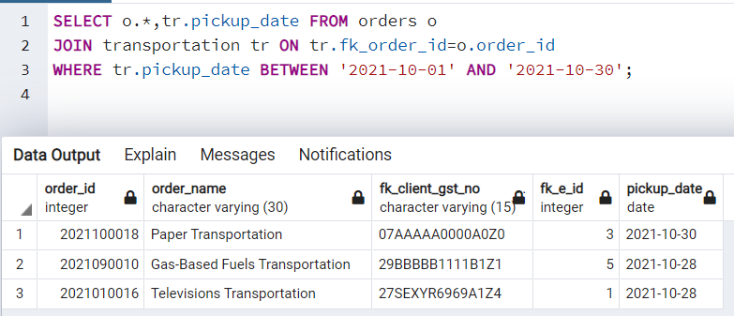
Query 1: List the Orders placed in a month

Slide 11
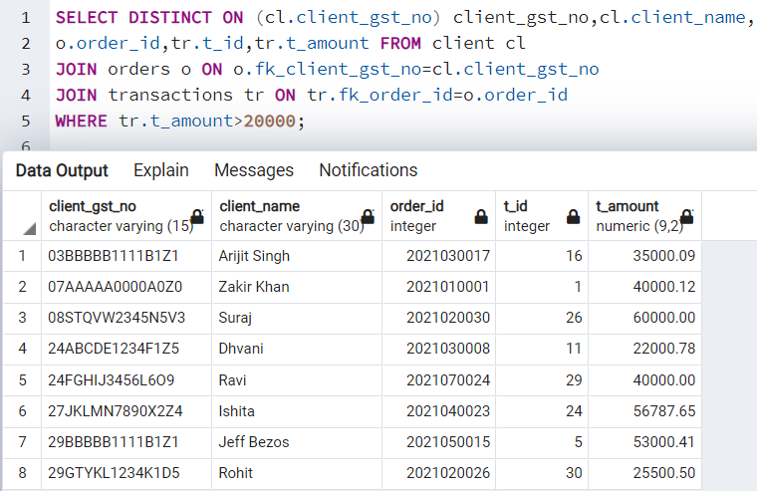
Query 2: Get client details where transaction amount is greater than 20000.

Slide 12
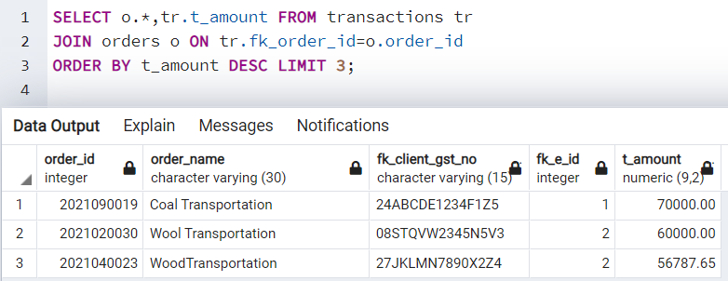
Query 3: Get order details of top three transaction amount.

Slide 13
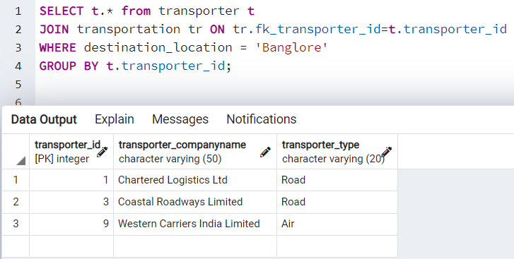
Query 4: List of transporters that have delivered orders to Banglore.

Slide 14
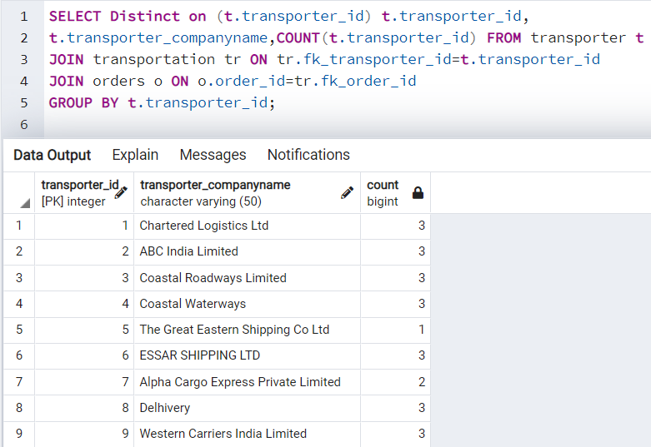
Query 5: No. of orders completed by each transporter

Slide 15
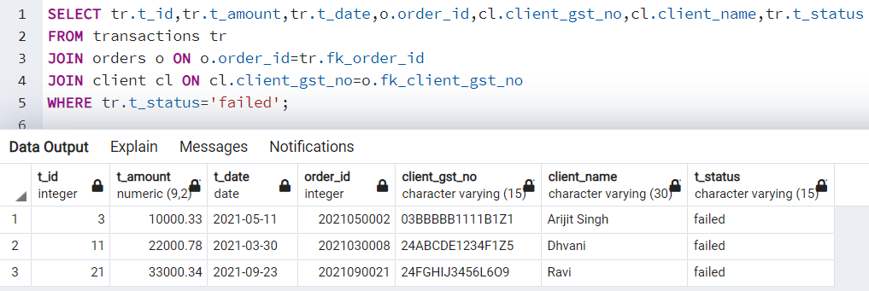
Query 6: Clients and orders details of all the failed transactions.

Slide 16
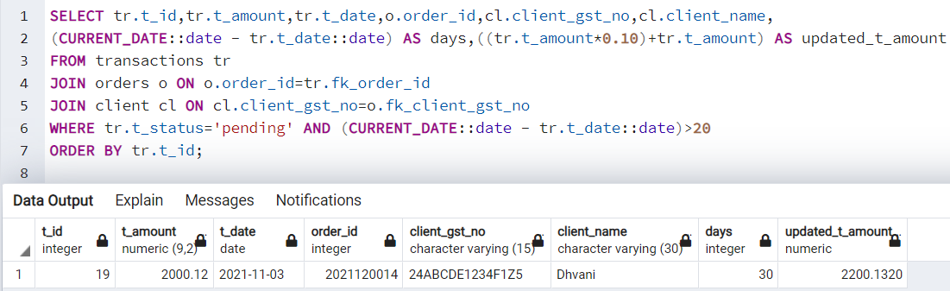
Query 7: Search people whose payment is pending for more than 20 days and add 10% penalty charges to their amount.

Slide 17
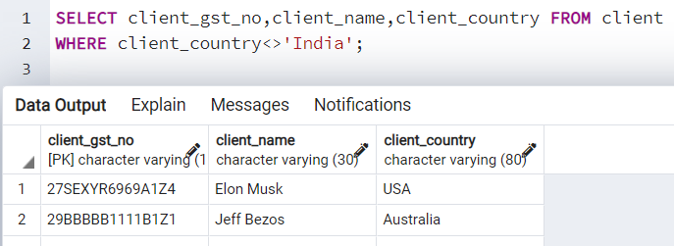
Query 8: List of International Clients.

Slide 18
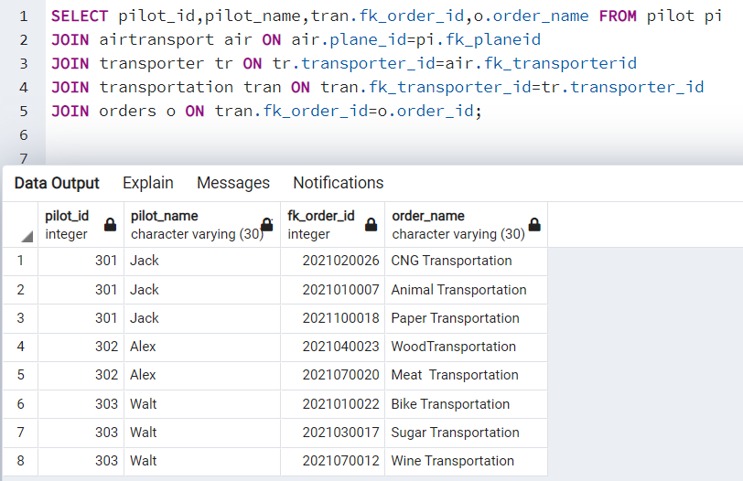
Query 9: Pilots and the orders delivered by them

Slide 19
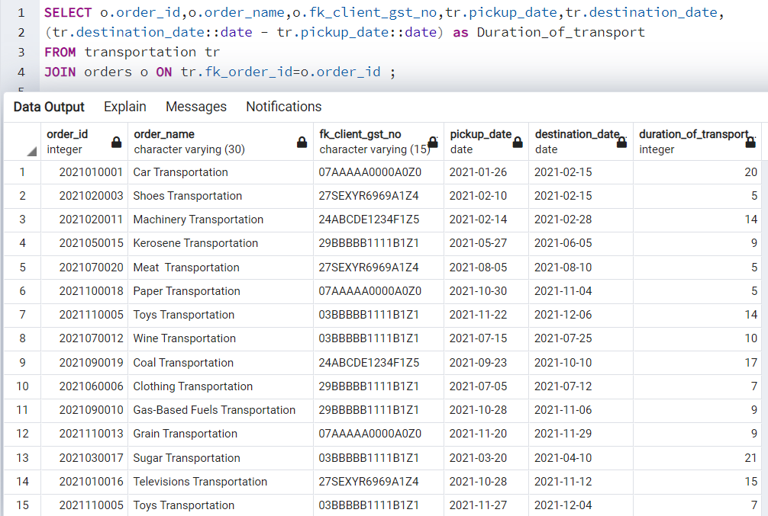
Query 10: Time taken for transportation of each order

Slide 20
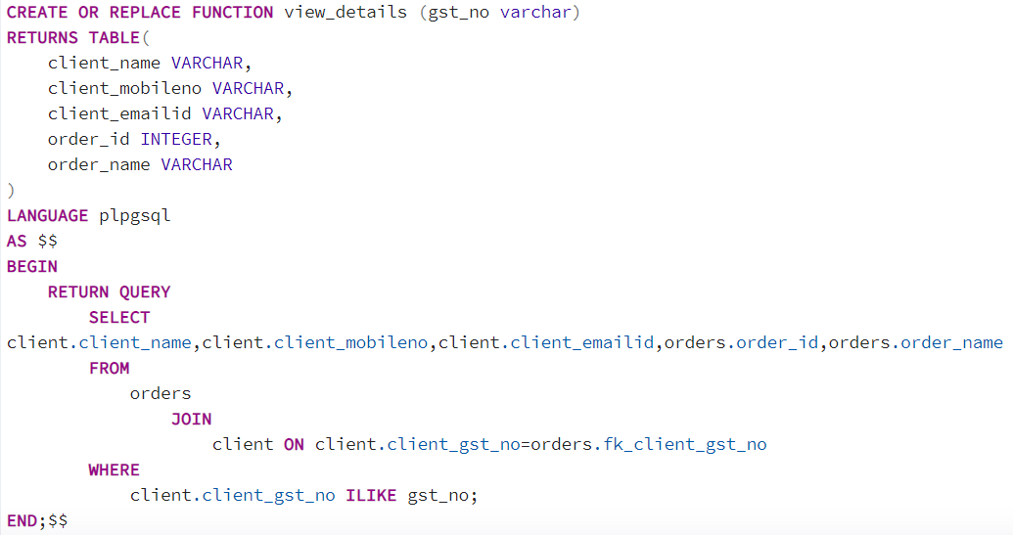
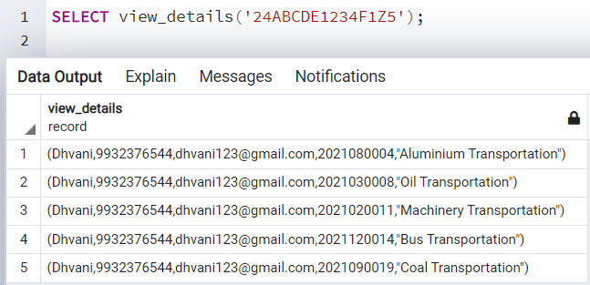
Query 11: Client Order Details

Slide 21
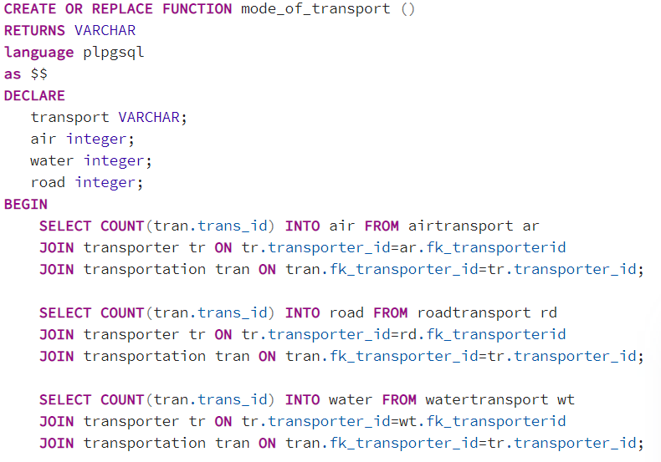
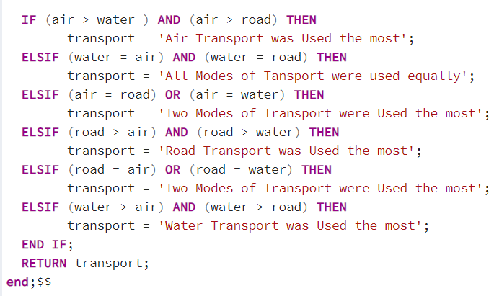
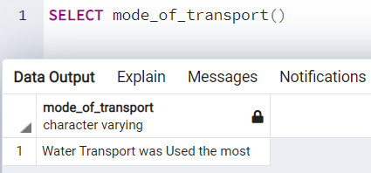
Query 12: Which mode of transportation is being used most?

Slide 22
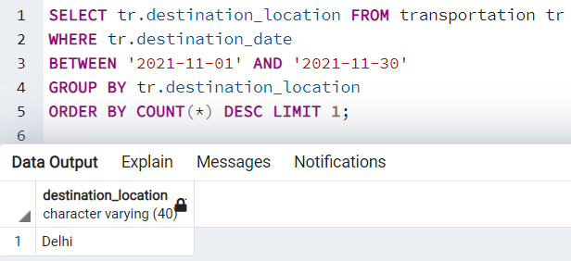
Query 13: Between the given date which region has maximum receivers

Slide 23
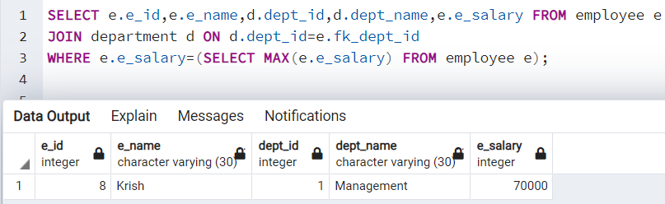
Query 14: List the employee having highest salary

Slide 24
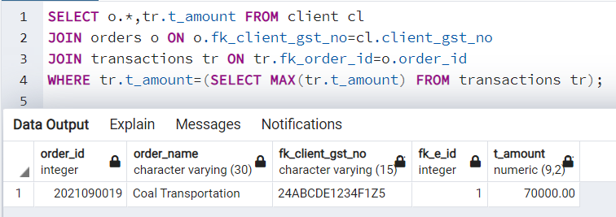
Query 15: Most Expensive Order

Slide 25
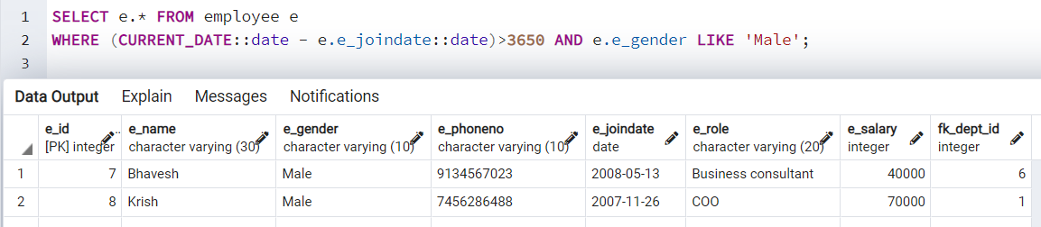
Query 16: List Male Employees working for the company for more than 10 years.

Slide 26
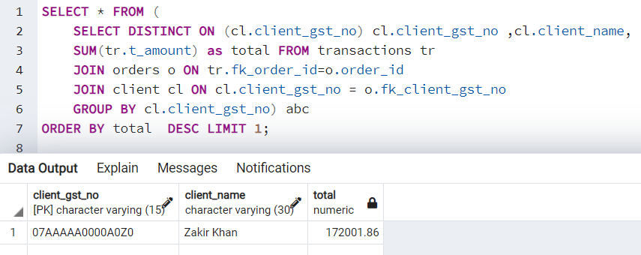
Query 17: Most valuable client

Slide 27
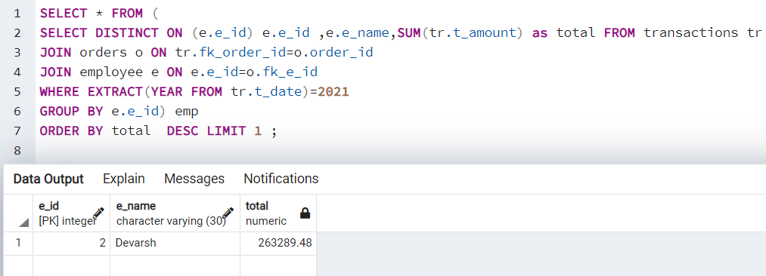
Query 18: Employee of the Year

Slide 28
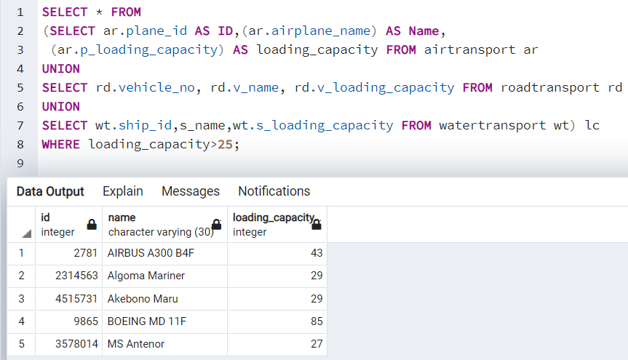
Query 19: All the available vehicles with Loading Capacity more than 25.

Slide 29
Conclusion
In conclusion, a database is a far more efficient mechanism to store and organize data than manual records; it allows for a centralized facility that can easily be modified and quickly shared among the company.
From this management system we get the idea of how many different entities are connected to each other and function altogether.
It also helps with all the queries that are encountered on a regular basis from as keeping track of all clients, receiver, employees with their department, transporters and vehicles to calculating employee of the month, most profitable client, duration of transport and all the scenarios one can imagine to obtain desired information.
Taking advantage of this Database Management System many employee can read, modify and use all the information efficiently for the benefit of the company simultaneously. Thus, this project is a key for all the issues that are faced in Logistics.

Slide 30
Thank you!!

